Slide 1
Employee Data Analysis using Excel
STUDENT NAME: Thilagavathy. S
REGISTER NO: 312217081(asunm1659312217081
DEPARTMENT: B. COM(General)
COLLEGE shri

Slide 2
PROJECT TITLE
VISUALIZING EMPLOYEE ATTENDANCE TRENDS WITH EXCEL CHARTS

Slide 3


AGENDA
Problem Statement
Project Overview
End Users
Our Solution and Proposition
Dataset Description
Modelling Approach
Results and Discussion
Conclusion
3/21/2024 Annual Review

Slide 4

PROBLEM STATEMENT
Visualizing employee attendance can be done effectively using several methods. Here are some common approaches:
1. Heat Maps: These show attendance trends over time, highlighting periods of high and low attendance with varying colors. They can help identify patterns or issues with attendance.
2. Bar Charts: These can display attendance data for different time periods (daily, weekly, monthly) or across different departments or teams.
3. Line Graphs:Useful for showing trends in attendance over time, helping to identify increases or decreases.
4. Pie Charts: Good for showing the proportion of attendance versus absenteeism, or the distribution of attendance across different categories or departments.
5. Dashboards: Combine multiple visualizations to provide a comprehensive view of attendance data. They can include heat maps, bar charts, line graphs, and key metrics.

Slide 5

PROJECT OVERVIEW
Here’s a concise project overview for "Visualizing Employee Attendance":Project Title:Visualizing Employee AttendanceProject Objective:To create a visual tool that effectively tracks and displays employee attendance, allowing HR and management to monitor patterns, identify issues, and make informed
decisions.Scope:- Data Collection: - Gather data on employee attendance, including clock-in/out times, absences, and late arrivals.
Data Processing:- Process attendance data to identify trends, absenteeism, and punctuality.
Data Visualization: - Design visual dashboards and reports that represent attendance data. - Include key metrics like attendance rates, trends over time, and comparisons across departments. Methodology:- Tools & Technologies: - Use software like Power BI, Tableau, or similar tools for visualization. - Data processing with Python, SQL, or Excel.
.

Slide 6

WHO ARE THE END USERS?
Who are the end users:The end users for the "Visualizing Employee Attendance" project typically include:1. HR Managers and Staff- Primary Users who will utilize the tool to monitor attendance, manage employee records, and identify trends related to absenteeism and punctuality. - They may also use the visualizations for performance reviews and compliance reporting.2. Department Managers and Team Leaders - They use the tool to track their team's attendance, identify any patterns or issues, and manage team productivity. - The data can help in scheduling, managing workloads, and addressing attendance-related concerns with employees.3. Senior Management and Executives: - Secondary Users who may use the visualizations to get an overview of company-wide attendance trends. - This can assist in strategic decision-making, such as workforce planning and policy adjustments -

Slide 7

OUR SOLUTION AND ITS VALUE PROPOSITION
Here’s a concise project overview for “Visualizing Employee Attendance”:Project Title:Visualizing Employee AttendanceProject Objective:To create a visual tool that effectively tracks and displays employee attendance, allowing HR and management to monitor patterns, identify issues, and make informed
decisions.Scope:- Data Collection: - Gather data on employee attendance, including clock-in/out times, absences, and late arrivals.
Data Processing: - Process attendance data to identify trends, absenteeism, and punctuality.
Data Visualization: - Design visual dash tools & Technologies: - Use software like Power BI, Tableau, or similar tools for visualization. - Data processing with Python, SQL, or Excel.- Development Approach: - Employ an agile development cycle with regular feedback .

Slide 8
Dataset Description
Dataset description :Here's a description of the dataset required for the "Visualizing Employee Attendance" project:Dataset Description for Visualizing Employee Attendance1. Employee Information: Employee ID: Unique identifier for each employee. - Name:Full name of the employee. - Department:The department or team the employee belongs to. - Job Title:The role or position held by the employee. 2. Attendance Records: - Date:The specific date of the attendance record. - Clock-In Time: The exact time the employee clocked in for the day. - Clock-Out Time: The exact time the employee clocked out.
3. Leave and Absence Data: Leave Request Date:Date when the leave was requested.
Leave Start Date: Date when the leave begins.
Leave End Date: Date when the leave ends. - Leave Type:Type of leave (e.g., Vacation, Sick, Maternity/Paternity, Bereavement).

Slide 9

THE "WOW" IN OUR SOLUTION
Our solution and it's value proposition:Our Solution:Our solution is a comprehensive, data-driven visualization tool designed to track, analyze, and present employee attendance in an intuitive and actionable format. The tool integrates seamlessly with existing HR systems, processes raw attendance data, and provides real-time insights through interactive dashboards.Key Features:Real-time Data Integration: Automatically syncs with HR systems to ensure up-to-date attendance records.- Interactive Dashboards: User-friendly interfaces that display attendance metrics, trends, and patterns across various departments and timeframes.- Customizable Views:Allows users to filter data by department, role, date range, and other relevant criteria.Value Proposition:Our solution offers significant value to organizations by transforming raw attendance data into meaningful insights, enabling better decision-making and more efficient management
3/21/2024 Annual Review
9

Slide 10
MODELLING
Modelling:Modeling for Visualizing Employee Attendance involves designing a structured framework that represents the data, processes, and relationships necessary to generate meaningful visual insights. 1. Data Modeling: Entity-Relationship Diagram (ERD): Entities: Employee: Attributes include Employee ID, Name, Department, Job Title, Date of Hire, Employment Type. Attendance Record: Attributes include Attendance ID, Date, Clock-In Time, Clock-Out Time, Work Hours, Attendance Status, Employee ID (foreign key). Leave Record: Attributes include Leave ID, Employee ID (foreign key), Leave Type, Leave Start Date, Leave End Date, Approval Status. Shift: Attributes include Shift ID, Shift Start Time, Shift End Time, Break Duration, Employee ID (foreign key). 2. Data Processing Model: ETL (Extract, Transform, Load) Process: Extract: Pull raw attendance and employee data from HR systems, time-tracking software, and other relevant databases. Transform: Data Cleaning: Handle missing values, correct inconsistencies, and standardize formats. Calculations: Derive additional fields like total work hours, overtime, attendance points, etc.
10

Slide 11
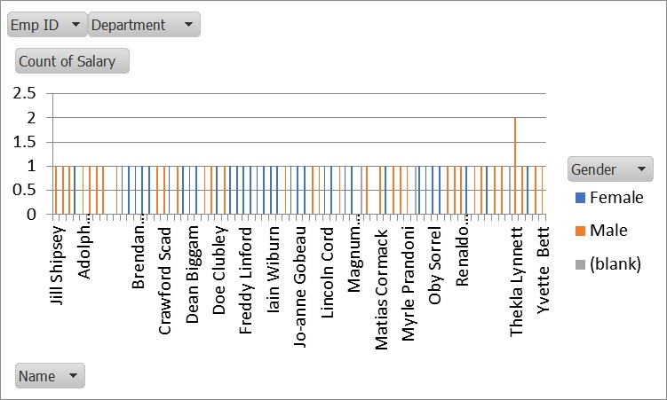
RESULTS
11

Slide 12
conclusion
Conclusion:In conclusion, visualizing employee attendance provides valuable insights into patterns, trends, and potential issues related to workforce management. Effective visualization helps in making informed decisions and promoting a culture of accountability and transparency within the workplace.

